Slide 1
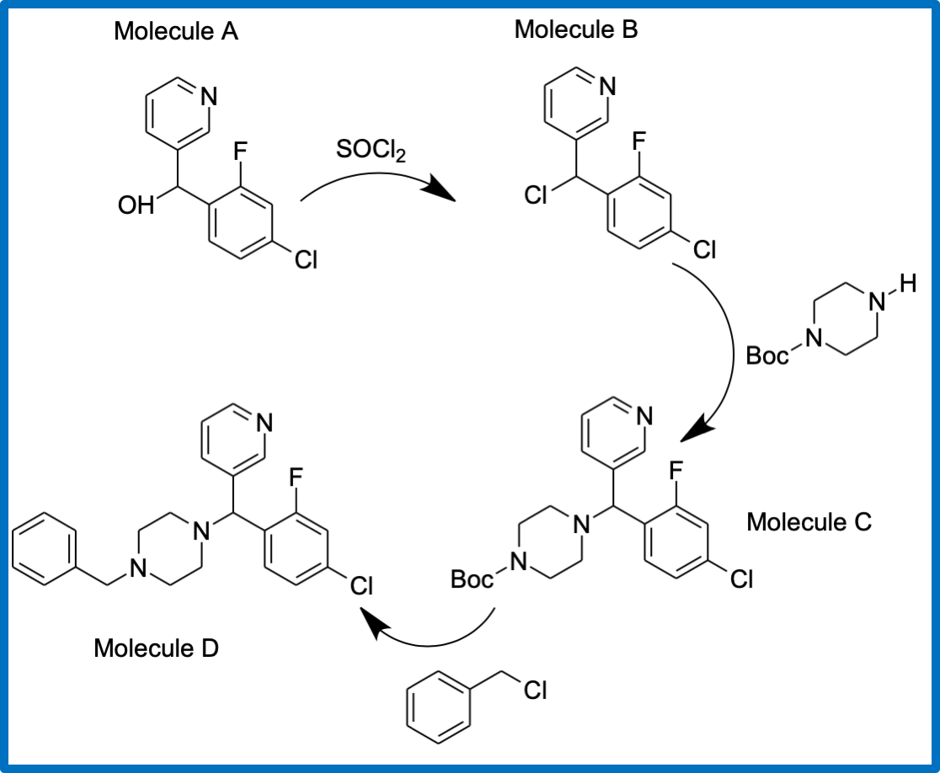
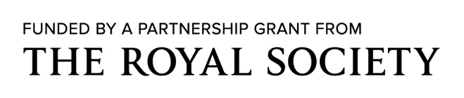


Open-Source Drug Design – collaborative research to cure mycetoma
S Toulmin, M Curson, J Fernandez Garcia, A Gupta, H Couchman, S Liaw, S Odinkalu, K Pastron, J Steiner, A Vrolijk Sevenoaks School
Professor M Todd, UCL
Overview
Mycetoma is a subcutaneous fungal disease, on the WHO’s list of Neglected Tropical Diseases. Current antifungal treatment is expensive and has a low success rate of around 30%, meaning amputation is often the ultimate solution. This causes physical disabilities for people whose lives depend upon physical labour. In the coming months we hope to contribute to open source research, synthesising a novel chemical entity that will aid efforts to find a cure. The collaborative nature of open source research gives new life to the search for an effective treatment, as there is no financial incentive for drug companies to work on this problem.
Aims
Produce at least one completely new molecule
Test the model of open-source scientific research in a school setting
Develop understanding of the potential for similar molecules to be synthesized
Background information
In the creation of a new molecule, there is a chance that the molecule formed will fit into an appropriate protein receptor of the fungus, meaning that it may cure mycetoma by either killing or disabling it. Thus we hope to form as many molecules as we can, following a similar method as outlined below with the same precursor molecule. Slight changes in what we add on to the molecule can change aspects such as its biological activity, solubility and toxicity. Repeating the synthesis with alternative substitutions will hopefully add rapidly to the library of possible molecules.
Methodology
As shown in the diagram, we will be starting with the precursor molecule ((4-chloro-2-fluorophenyl)(pyridin-3-yl) methanol) which has been provided to us via DNDi
Reaction with thionyl chloride replaces the OH group with a Cl group, with gaseous by-products
After this we will use a two-step process in order to substitute a piperazine derivative for the Cl
Using a BOC protecting group ensures that the functional group of Molecule B remains intact allowing us to synthesize the correct molecule in the last reaction
We will then de-protect our molecule by using trifluoroacetic acid, followed by separation and substitution with benzyl chloride
Predicted results
Once we have synthesized the molecule we will purify it and analyse using IR spectroscopy. We will send it to the group at UCL where it will be analysed using NMR and chromatographic techniques. If the testing at UCL is successful, it will then be sent to Dr WJ van de Sande in the Netherlands who will further test the molecule in vitro and in vivo. In vitro refers to studies performed on microorganisms, in this case, the fungus eumycetoma, screening the molecule’s efficiency at reducing eumycetoma’s growth rate. In vivo refers to studies performed on living organisms, for instance a moth’s larvae, that are infected with the mycetoma fungus, where their survival will be monitored over a period of time.
Next steps
We hope to begin testing our synthetic protocol in November. We also aim to make this process as sustainable as possible, using green chemistry techniques where appropriate.

